Slide 1
UNIT - III Configuration Management

Slide 2
1. Introduction - Configuration Management
The process of software development and evolution is controlled is called configuration management.
Without control, product integrity is lost.
Example:
Suppose that a customer reports a bug in a software system. In order to address this situation, it is necessary to know which product the customer is using.
The executable code that the customer is running must be matched with the appropriate source code.
This is not always possible if changes and updates to the software have not been properly controlled. Maybe the source code for this version (and perhaps several subsequent
versions) was not kept.

Slide 3
2. Definitions
Baseline - The arrangement of related entities that make up a particular software configuration. Any change made to a software system relates to a specific baseline. Baselines can be defined at each stage of the software life-cycle, for example functional baseline, design baseline, product baseline, etc.
Change - the act, process or result of being altered.
Change control - keeping track of the process of making a modification.
Configuration - A mode of arrangement, confirmation or outline; the relative position of the component parts of a system
Configuration management - "The discipline of developing uniform descriptions of a complex product at discrete points in its life-cycle with a view to controlling systematically the manner in which the product evolves "

Slide 4
2. Definitions
Software change control - keeping track of the process of making modifications to a software system.
Software configuration - The current state of the software system and the interrelationship between the constituent components such as the source code, the data files and the documentation
Software configuration management - Configuration management related specifically to software systems.
Software documentation - the written record of facts about a software system recorded with the intent to convey purpose, content and clarity
Variant - Source and object specialised to different platforms. For example, Microsoft Word for Windows for the PC and Microsoft Word for Windows for the Macintosh are variants of the same product.
Version - a small change to a software configuration.
Version control - Keeping track of baselines, versions of baselines and the relationships between them.

Slide 5
3. Configuration Management
Configuration management was established as a field in its own right in the 1950's with the primary purpose of reproducibility of products
Now recognised as an activity that is critical to the management and maintenance of any large system including one software based.
Configuration management activities fall into four broad categories:
1. The identification of the components and changes;
2. The control of the way the changes are made;
3. Auditing the changes - making the current state visible so that adherence to requirements can be assessed;
4. Status accounting - recording and documenting all the activities that have taken place.
Responsibility of configuration management team with a configuration manager.
Its management responsibility to avoid redo in modification (due to unawareness) of a module that was already done by a programmer

Slide 6
3. Configuration Management
All components of the system's configuration are recorded along with all relationships and dependencies between them.
Any change - addition, deletion, modification - must be recorded and its effects upon the rest of the system's components checked.
After a change has been made, a new configuration is recorded.
There is a need to know who is responsible for every procedure and process along the way.
It is a management task both to assign these responsibilities and to conduct audits to see that they are carried out.

Slide 7
3. Configuration Management
Mini Case Study - Giving Appropriate Guidance and Direction
The management task of assigning appropriate responsibility applies at many levels. Problems in non-software-related tasks can affect software development and vice versa.
At the research institute attached to the ACME Health Clinic, a large research project involved the conducting of a wide-ranging survey during its first year. In the second year of the project, there were complaints that a software development group's work was held up because the results of the survey were not available.
In fact, the survey had been done and the information gathered but no one had been able to give guidance to the survey team about how to collate and present their results. The staff and resource had been available to do the work but because no one had explicit responsibility for overseeing the interface between the survey team and the rest of the project, delays were caused.

Slide 8
3. Configuration Management
Major aim in configuration management and change control is reproducibility.
to reconstitute both the product and the process at any stage in its evolution.
Three objectives of configuration management are control, consistency and minimising cost.
(1) Control: Software maintenance is the evolutionary nature of software systems. If the process by which such systems evolve is not controlled, chaos can result.
Configuration management is necessary because software systems have a long lifetime and are subject to change. Constant change to workable live software systems is bound to lead to problems without a proper means of control.
(2)Consistency: Configuration management is necessary to ensure the production of consistent sets of software products:
A. Consistent sets of documents (final deliverables and manuals)
standardised document identification which allows for versioning and indexing, standard reporting mechanisms
B. Consistent software releases
standardised version and product release control is needed (version control)
(3) Cost: to ensure that the changes are made such that overall costs are minimised. This means cost of future maintenance as well as the cost of the immediate change.

Slide 9
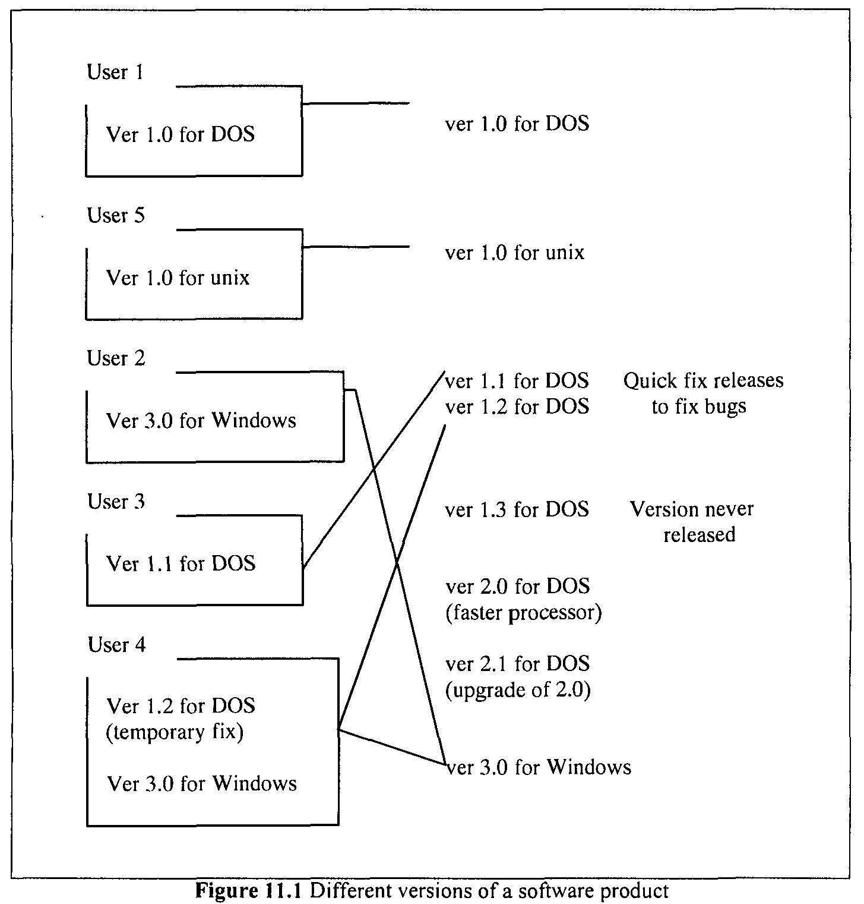
3. Configuration Management

Slide 10
3. Configuration Management
Without consistent and accurate records and documentation, it will be impossible to keep track of this, whereas proper procedures will enable the identification of
the software version in use by a particular user - attempting a repair of the wrong version will only make things worse;
the options for upgrade - to know which options are viable in the user's environment;
the levels at which different versions are compatible - the structure of data files, for example, attempting to run an inappropriate version might lead to corruption of the user's data;
the source code corresponding to a specific version - it is vital to be able to trace and reproduce the source code for new version despite the fact this might not correspond to any executable version currently in use.
Without a structured approach it is impossible to guarantee
i. the integrity of the system,
ii. that the course of evolution is traceable or
iii. that correlation between all the different parts of the system is
identifiable.
considerable skill is needed in both selection of the right techniques and methodologies and the effective imposition of them upon the software development and maintenance process.

Slide 11
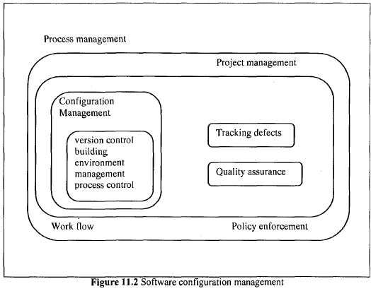
3.1 A Specific View of Software Configuration Management
The choice of specific procedures depends upon many things, for example the working environment and the resources available.

Slide 12
3.1 A Specific View of Software Configuration Management
Leblang views it as a four-part process
1. version control
2. building
3. environment management and
4. process control
These categories sit within an overall process where collective control is the task of process management
1. Version Control
A S/w product company has to maintain this product in many different versions.
Reasons are,
- Not all users will upgrade to the latest version simultaneously.
- The latest version might imply a change in operating system.
- A company cannot abandon a product and with it a large customer base just because it has developed a better version that runs on a more up-to-date platform.
- a company cannot abandon users of a previous version just because a newer version has been released.
So, a company will be supporting many versions of a product. Control of the evolution of a single system is no trivial task. When multiple versions and upgrades have to be considered, the task becomes a huge one.

Slide 13
3.1 A Specific View of Software Configuration Management
During the process of software evolution, many objects are produced, for example files, electronic documents, paper documents, source code, executable code and bitmap graphics.
A version control system keeps track of all the changes to every object and can also support parallel development by allowing branching of versions.
Figure 11.3 shows version control at its simplest where the current version of the whole system is given by version 2 of object 1, version 3 of object 2, version 4 of object 3 and version 2 of object 4.
In a more complex system where, parallel development must be supported, branching may occur (Figure 11.4). It is not a simple matter to identify the latest version of the object.
Version 2.2 might be a later version than version 4.0, for example. The version control system must control the creation of these variants as well as the merging of the different versions to form a complete system. (Version control tools exist)

Slide 14
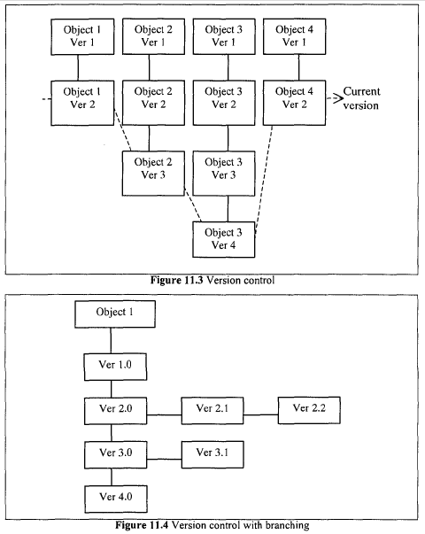
3.1 A Specific View of Software Configuration Management

Slide 15
3.1 A Specific View of Software Configuration Management
2. Building
Software systems must be built and rebuilt from the objects of which they are made.
These objects will evolve and change and the management of building the system must ensure that the correct product can be produced reliably.
Automatic build tools might involve minimal rebuilding - reusing objects where possible and rebuilding only where an object has changed or has had a dependency change.
Documentation is vital and build tools should produce the documentation necessary to
recreate the complete file system environment for any specific build.
Objects must be built from the appropriate versions of the sources using the appropriate tools.
Automated systems ensure that the correct version of the sources is used do not always ensure that the correct tools, for example the right version of the compiler, are used.
Traditional tools require that the user specifies module dependencies via some sort of system model like a make file.
The manual updating of a system model is unsatisfactory as it is all too easy to fail to declare all dependencies, especially as the system configuration changes. System model generators automate this process but might be language specific, can be slow, and are not always reliable in all circumstances.
However, as their use has become more widespread, their reliability has improved.

Slide 16
3.1 A Specific View of Software Configuration Management
3. Environment Management
This is the means by which the file system is managed.
to ensure that the appropriate versions of files are selected and that the
environment at any stage may be reproduced.
must take account of the need both to share objects and to keep objects apart from each other.
For example, a maintenance programmer must be able to make changes to an object without the changes having any effect upon the system as a whole prior to such change being completed, verified and accepted as part of the system.
On the other hand, it must be possible to test the results of change upon the system as a whole and to test one change against another.
4. Process Control
It is the means by which configuration management interacts with the wider aspects of the organisation and controls the way that other processes interact with each other.
The configuration management process must interact with all the processes and methodologies used, for example the design and analysis methodologies.

Slide 17
Why Software Configuration Management ?
The problem:
Multiple people have to work on software that is changing
More than one version of the software has to be supported:
Released systems
Custom configured systems (different functionality)
System(s) under development
Software must run on different machines and operating systems
Need for coordination
Software Configuration Management
manages evolving software systems
controls the costs involved in making changes to a system

Slide 18
What is Software Configuration Management
Definition:
A set of management disciplines within the software engineering process to develop a baseline.
Description:
Software Configuration Management encompasses the disciplines and techniques of initiating, evaluating and controlling change to software products during and after the software engineering process.
Standards (approved by ANSI)
IEEE 828: Software Configuration Management Plans
IEEE 1042: Guide to Software Configuration Management
Forward Definition!

Slide 19
SCM Activities
Software Configuration Management (SCM) Activities:
Configuration item identification
Promotion management
Release management
Branch management
Variant management
Change management

Slide 20
SCM Activities (continued)
Configuration item identification
modeling of the system as a set of evolving components
Promotion management
is the creation of versions for other developers
Release management
is the creation of versions for the clients and users
Branch management
is the management of concurrent development
Variant management
is the management of versions intended to coexist
Change management
is the handling, approval and tracking of change requests

Slide 21
SCM Roles
Configuration Manager
Responsible for identifying configuration items. The configuration manager can also be responsible for defining the procedures for creating promotions and releases
Change control board member
Responsible for approving or rejecting change requests
Developer
Creates promotions triggered by change requests or the normal activities of development. The developer checks in changes and resolves conflicts
Auditor
Responsible for the selection and evaluation of promotions for release and for ensuring the consistency and completeness of this release

Slide 22
More on Baselines
As systems are developed, a series of baselines is developed, usually after a review (analysis review, design review, code review, system testing, client acceptance, ...)
Developmental baseline (RAD, SDD, Integration Test, ...)
Goal: Coordinate engineering activities.
Functional baseline (first prototype, alpha release, beta release)
Goal: Get first customer experiences with functional system.
Product baseline (product)
Goal: Coordinate sales and customer support.
Many naming scheme for baselines exist (1.0, 6.01a, ...)
3 digit scheme:
7.5.5
Release
(Customer)
Version
(Developer)
Revision
(Developer)

Slide 23
SCM Directories
Programmer’s Directory (IEEE: Dynamic Library)
Library for holding newly created or modified software entities. The programmer’s workspace is controlled by the programmer only.
Master Directory (IEEE: Controlled Library)
Manages the current baseline(s) and for controlling changes made to them. Entry is controlled, usually after verification. Changes must be authorized.
Software Repository (IEEE: Static Library)
Archive for the various baselines released for general use. Copies of these baselines may be made available to requesting organizations.

Slide 24
4. Change Control
Change control concerns the specific area comprising the sequence of events starting with a request for a change to a live software system and ending with either the approval of a system incorporating the change or a rejection of the request for change.

Slide 25
4. Change Control
Activities which comprise change control as:
Selection from the top of a priority list.
Reproduction of the problem (if there is one)
Analysis of code (and specifications if available).
Incorporation of change.
Design of changes and tests.
Quality assurance.

Slide 26
4.1. The Responsibilities of Management in Change Control
1.Deciding if the change should be made:
This is the job of a Change Control Board. A request for change must be analysed to see if it is valid. Is it a requirement for a genuine change or does it stem perhaps from a user's misunderstanding of existing functionality?
A potential change must be costed. The cost of making the change must be balanced against the benefit that will accrue from it.
It is the job of the Change Control Board to decide whether or not to accept a request for change.
A change request form that gives details of the change requested and the action taken.
These forms are very useful form of documentation.
The Change Control Board considers the effect of a change from a strategic and organisational viewpoint rather than a technical one and decides whether or not the change would be cost-effective.

Slide 27
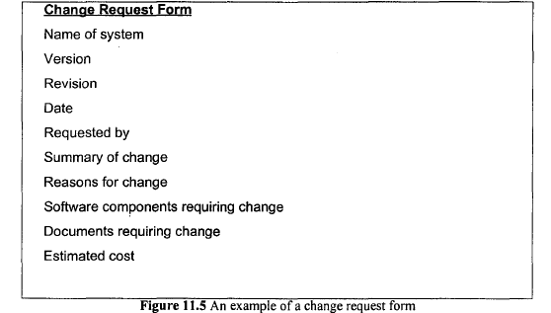

Slide 28
4.1. The Responsibilities of Management in Change Control
2. Managing the implementation of the change:
The outcomes of making a change must be assessed. This assessment will have begins as part of the costing process.
3. Verifying the quality:
Implementation of a change should be subject to quality control.

Slide 29
5. Documentation
A key component in the general control of change and specific control of the processes of software evolution is documentation
5.1. Categories of Software Documentation
Two main categories are: user documentation and
system documentation
User documentation refers to those documents containing
descriptions of the functions of a system without reference to how these functions are implemented
System documentation contains documents which describe all facets of the system, including analysis, specification, design, implementation, testing, security, error diagnosis and recovery

Slide 30
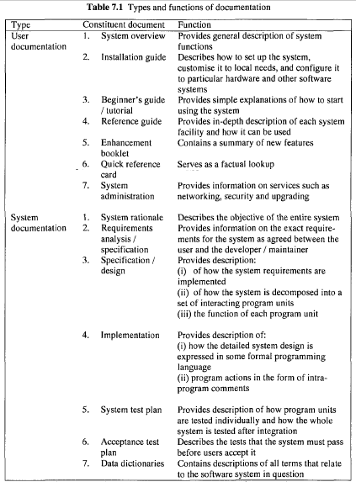

Slide 31
Macro argues that there are three classes of documentation: user manuals, operator manuals and maintenance manuals
The user manual describes what the system does without necessarily going into the details of how it does it or how to get the system to do it.
The operator manual describes how to use the system as well as giving instructions on how to recover from faults.
The maintenance manual contains details of the functional specification, software design, high quality code listings, test data and results.

Slide 32
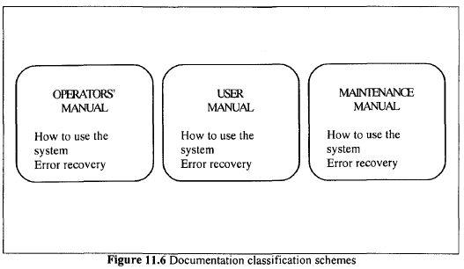

Slide 33
The list of software documents presented in the Table 7.1 is not exhaustive. The type, content and sometimes name of each document will vary between systems. This variation is caused by a number of factors that include:
Development methodology
Category of customer
Version of the system

Slide 34
5.2. Role of Software Documentation
a. To facilitate program comprehension
b. To act as a guide to the user
providing an initial and accurate description of what the system can do. As such, the user can decide whether or not the system can satisfy his or her needs. To achieve this, the documents must be written and arranged in such a way that the user can easily find what is required.
providing information that enables the user to install the system and customise it to local needs.
providing technical information on how to handle malfunctions.
c. To complement the system

Slide 35
5.3. Producing and Maintaining Quality Documentation
Osborne contends that the cost of maintaining a software system is proportional to the effectiveness of the documentation which describes what the system does as well as the logic used to accomplish its tasks
Guidelines on producing software documents:
Writing style: adhering to guidelines for clear and understandable text
Adhering to document standards: for example, standard coversheets can ensure traceability of documents.
Standards and quality assessment: putting documents through a
quality assessment process will help to ensure conformance to standards.
- Documentation techniques:
Keep document up to date
Keep good design principle methodologies
Documentation support tools: for the classification and updating of documentation. Appropriate tools can ensure consistency in documents

Slide 36
Management and Organisational issues

Slide 37
1. Introduction
A transition from small special-purpose programs - e.g. mathematical functions - to very complex applications - e.g. real-time systems and embedded systems; and from one-person tasks to team tasks (i.e. to project level) primarily because the complexity surpassed that which could be managed by a single individual
management-related issues have taken on a greater significance
The management of personnel and the organisation of maintenance tasks relates closely to the equivalent activities in development projects.
personnel management with respect to the required qualities, motivational factors, team dynamics, improving productivity and provision of adequate education and training.
the different approaches that can be used to organise maintenance tasks.

Slide 38
2. Definitions
Management - the act or art of exercising executive, administrative and supervisory direction.
Team working - a number of people associated together in carrying out a task.

Slide 39
3. Management Responsibilities
Large and complex software systems are the ones that present challenges for management because:
they form an integral part of an organisation,
their ability to evolve is at the heart of their operation, and
their maintenance requires the services of large numbers of personnel.
the role of maintenance personnel is central to the successful operation

Slide 40
Management has the responsibility of ensuring that the software system under maintenance is of a satisfactory quality, and that desired changes are effected with the minimum delay at the least possible cost. This can be achieved by:
devising a means of managing maintenance personnel in order to increase their productivity, ensure job satisfaction and improve system quality, choice of personnel, motivation, a suitable team structure and education and training;
selecting a suitable way of organising maintenance tasks so as to increase productivity, control maintenance effort and cost, and deliver a high quality system

Slide 41
4. Enhancing Maintenance Productivity
The aim of management is to maximise productivity
It is a management task to find the right people for the job, then to see that they are motivated, and given the necessary information and resources to do the job well
Also, the management team to equip itself with sufficient knowledge of the area it is managing.

Slide 42
4.1 Choosing the Right People
Choosing the right people for the job in terms of specific skills and experience
Once a team is in place, the single most important factor influencing productivity is motivation.
The COCOMO analysis of 24 maintenance projects and 63 development projects indicated that the single most important factor in increasing productivity is to get the right people for the job

Slide 43
4.2 Motivating Maintenance Personnel
Software maintenance still has an image problem. As a result, management has a much more difficult task motivating maintenance personnel than motivating development personnel.
Attitudes of management can affect the quantity and quality of work that subordinates achieve
Some ways of motivating personnel are through
Rewards (such as bonus, promotion)
Appropriate supervision (technical supervision from seniors)
assignment patterns (rotate maintenance personnel between maintenance and development tasks)
Recognition (acknowledgement)
Career structure (maintenance enhances the assets)

Slide 44
4.3 Communication
Ensure effective communication between management and personnel.
Management keep maintenance personnel informed.
If staff are unaware of what the procedures are, for example for document control, and why they have been put in place, they will be unable to follow them effectively or give competent feedback on problems associated with them
Information must flow in both directions (the maintenance process is properly controlled), and information may be gathered on the processes so that benefits may be documented and quantified

Slide 45
4.4 Adequate Resources
Resources can be viewed in terms of tools - software and hardware – and working environment.
Maintenance programmers put software tools at the top of their list to increase productivity.
Investing enough in maintenance staff also includes employing the appropriate number of staff. Over-stretching too few good people can lead to dissatisfaction with the working environment.

Slide 46
4.5 Domain Knowledge
Managers must have adequate knowledge of the maintenance process (to be effective)
they need to be aware of the cost implications of the various maintenance stages in order to be able to guide the maintenance process effectively.
For example, management needs to know that the analysis of existing code is one of the most
expensive phases
Without this knowledge, it is difficult to make effective decisions as to how to tackle problems or how best to invest resources.

Slide 47
5. Maintenance Teams
It is an important factor in determining the level of productivity.
For example, a team where personnel are changing will be bad for productivity because of the lag time involved in bringing new staff up to speed on a project.

Slide 48
Generally two types of team used in development are egoless programming and the chief programmer team
(1) The egoless programming team is an organisational structure of individuals whose operation is based on the philosophy that everyone involved in a project should work together to develop the best possible software system.
(2) The chief programmer team imposes an organisational structure in which clear leadership and functional separation play a major role
Its objectives are to organise software maintenance into clearly-defined tasks, to create an environment that promotes the use of state-of-the-art tools, and to ensure that at least two people understand every line of code.
It differs egoless programming in the lack of a comparable level of democracy

Slide 49
To address the problem of differences in maintenance process that a change request for a small or major maintenance task
Martin and McClure have suggested two types ofmaintenance team: the short-term (temporary) team and the long-term(permanent) team

Slide 50
5.1 Temporary Team
It is created on an informal basis when there is a need to perform a specific task, for example a code review.
The programmers work together to solve the problem
Leadership is not fixed; it rotates between the team members.
The main problem with this arrangement is that program quality, programmer morale and user satisfaction can be compromised

Slide 51
5.2 Permanent Team
It is a more formal arrangement.
It allows for specialisation, creates communication channels, promotes an egoless, collegiate atmosphere, reduces dependency on individuals and allows for periodic audit checks
It is created on a permanent basis to oversee the successful evolution of a software system throughout its lifetime.
The team consists of a maintenance leader, a co-leader, a user-liaison person, a maintenance administrator and other programmers

Slide 52
The maintenance leader provides technical support to the whole team. He or she is responsible to the maintenance administrator.
The co leader is an assistant to the maintenance leader
The user-liaison person is charged with linking the users and the maintenance team
The maintenance administrator is the administrator with a range of responsibilities such as hiring, firing and promotion of staff.
The maintenance programmers perform problem diagnosis and implement change under the supervision of the maintenance leader.

Slide 53
6. Personnel Education and Training
The personnel of an organisation are central to its successful operation.
Their full potential and contribution may be undermined by the lack of education and training.
Education and training in software maintenance is a traditionally neglected area.
Few software engineering degrees even devote a full lecture course to the topic and training has tended to be ad hoc
A few Universities, for example the University of Durham, UK, and the University of Maryland, USA, devote a significant proportion of their degree programme to maintenance issues

Slide 54
6.1 Objectives
(1) To Raise the Level of Awareness
Maintenance personnel need to understand the processes and procedures of maintenance - especially the key differences and relationship between development and maintenance - to do their job effectively
The reasons for this are as follows:
From a management perspective, maintenance managers must understand the specific needs of the maintenance environment in which they operate.
- A thorough appreciation of the issues concerned with maintenance can assist in better management -
planning and control - of maintenance activities.

Slide 55
From a maintenance programmer's point of view, it is important for the programmer to recognise that maintenance is not just a peripheral activity in an organisation, it is at the heart of the organisation's functioning.
(Maintenace is more vital for the highly computerised organization)
In circumstances where inexperienced staff (e.g. newly recruited graduates) are assigned to maintenance jobs, it is common for them to notice that the task they are working on is remote from what was taught to them in University or College courses
(Universities and colleges can improve the maintenance skill levels)
Software maintenance still has an image problem. One of the reasons for this is lack of understanding of what software maintenance really is; it is often perceived as corrective change

Slide 56
(2) To Enhance Recognition
In organisations whose operation depends on the successful evolution of their software systems, it needs to be recognised within the management
structure that maintenance is a vital and valuable activity.
When carried out effectively it can ensure successful running of systems and lead to increased customer satisfaction

Slide 57
6.2 Education and Training Strategies
Number of ways for the education and training of maintainers which include University education, in service training, self-tuition, conferences and workshops
University education
conferences and workshops
Hands-on experience

Slide 58
7. Organisational Modes
Different modes of organising maintenance activities
7.1 Combined Development and Maintenance
The combination of development and maintenance activities may depend on the type of change (change ownership), program modules (module ownership), activity domains (W-Type), application domains (A-Type)and life-cycle phase (L-Type).

Slide 59
Module Ownership
This mode requires that each member of the team is assigned ownership of a module
The module owner is responsible for effecting any changes that need to be implemented in that module
The main advantage is that the module owner develops a high level of expertise in the module
Its weaknesses are:
Nobody is responsible for the overall software system.
The workload may not be evenly distributed.
It is difficult to implement enhancements due to unknown
dependencies.
It is difficult to enforce coding standards

Slide 60
(2) Change Ownership
In this mode each person is responsible for one or more change no matter which modules are affected. That is, the person is also responsible for the analysis, specification, design, implementation and testing of the change
The strengths are:
There is a tendency to adhere to standards set for the whole software system.
Integrity of the change is ensured.
Changes can be coded and tested independently.
Code inspection tends to be taken seriously.
Its weaknesses are:
Training of new personnel takes much more time than it would for the module ownership mode
(knowledge of the entire system is required)
Individuals do not have long-lasting responsibilities, but instead have a series of transient responsibilities

Slide 61
(3) Work-Type
The key feature of this mode is that there is 'departmentalisation' by work type; analysis, specification, etc.
Those in the different departments work as a team but with clearly defined responsibilities and roles.
The main strength is that members in each department develop specialised knowledge and skills.
The drawback is the cost of co-ordinating the different departments

Slide 62
(4) Application-Type
With this mode, division is based on application areas such as health information systems or office automation.
The advantage is that members of the team develop specialised application knowledge
Its drawback is the cost of co-ordinating of the various application domains.

Slide 63
7.2 Separate Maintenance Department
Its strengths are:
There is clear accountability.
It allows development staff to concentrate on development of new software systems.
It facilitates and motivates acceptance testing just after development.
It encourages high quality end-user service.
Its weaknesses are:
There is a danger of demotivation due to status differences
The developers tend to lose system knowledge after the system is installed.
There is a high cost involved in the co-ordination of development and maintenance when needed.
There may be duplication of communication channels.

Slide 64
Some organizations provide support to the maintenance team by assigning some members of the development team to join the maintenance team on installation of the system.
Lientz and Swanson have called these members the maintenance escort .
This is usually a temporary measure; the maintenance escorts return to development work after ensuring that the system functions according to the agreed specification.
At times, the maintenance escorts may become permanent members of the maintenance team by virtue of their familiarity with the system during its development.

